Slide 1

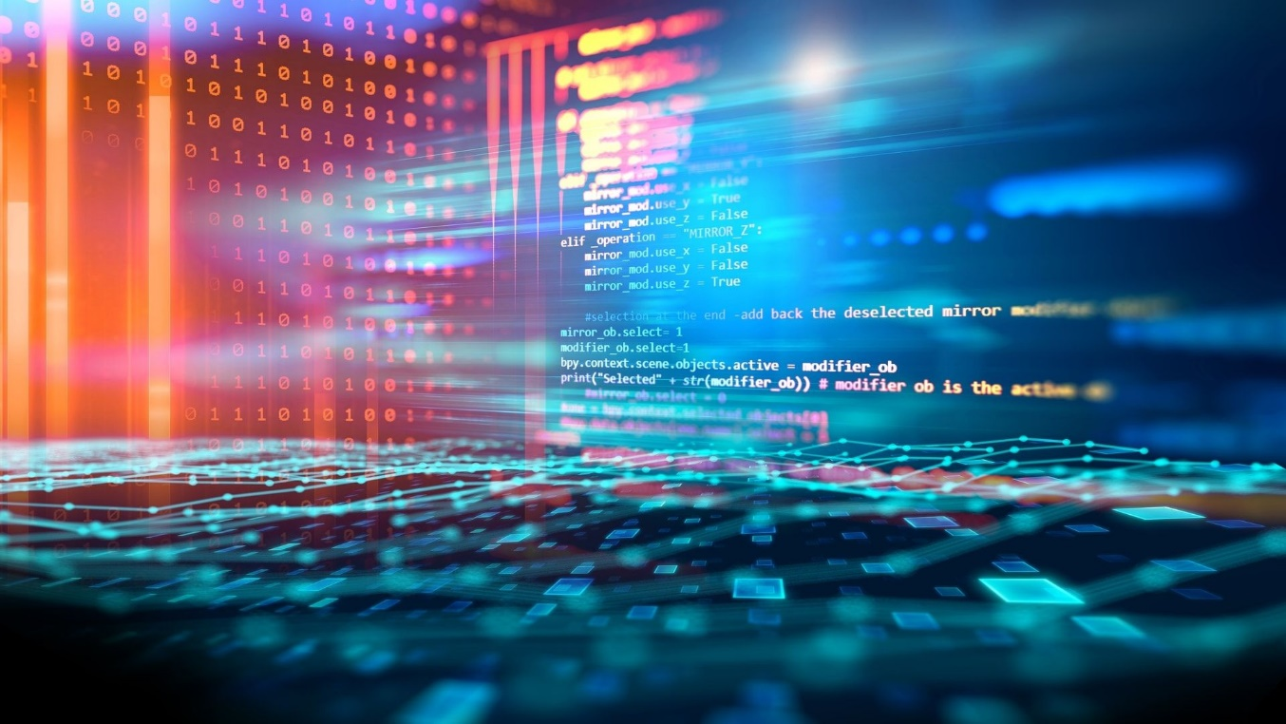
Foundations of
Scientific Computing
(SciComp 101)
Dave Biersach
dbiersach@bnl.gov
Session 01 Introducing Scientific Computing

Slide 2



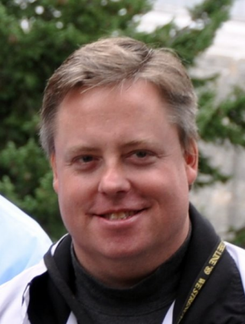

Welcome!
My name is Dave Biersach
I am a Senior Technology Architect at BNL
I am a 1989 graduate of the United States Military Academy at West Point, and I served in the Persian Gulf War as a Combat Engineer
I worked for DARPA, developing satellite counter-reconnaissance search algorithms
I have worked at Microsoft & Pfizer
I have been married for 34 years, have three adult children, two dogs, and have mentored students for the past 15 years

Slide 3
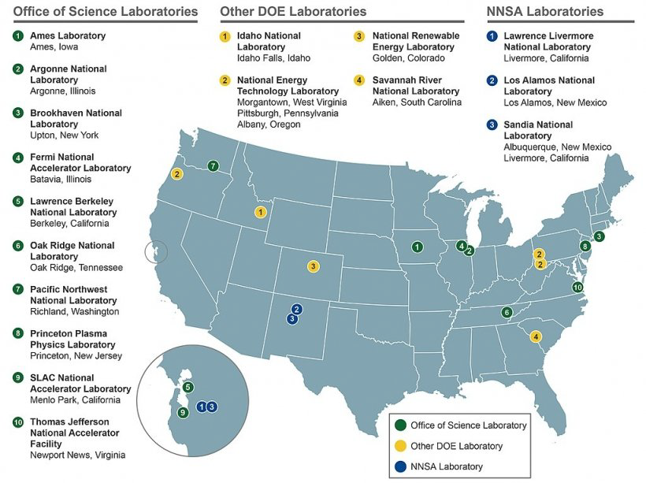
The US Department of Energy
National Nuclear
Safety Administration
17 National Labs across the USA
Student research opportunities exist at all US Labs

Slide 4
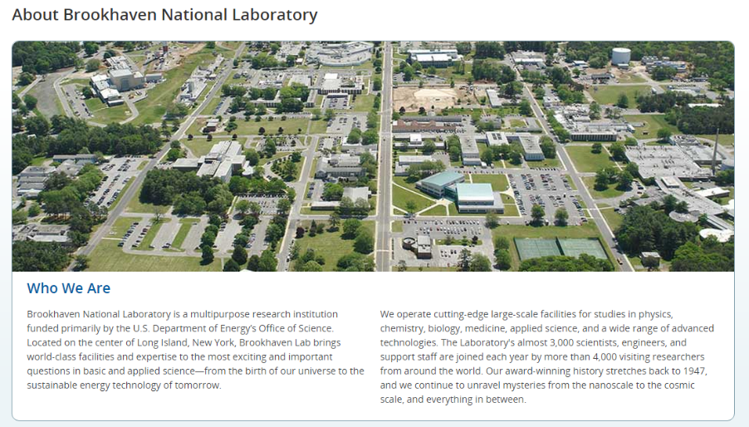
https://www.bnl.gov

Slide 5
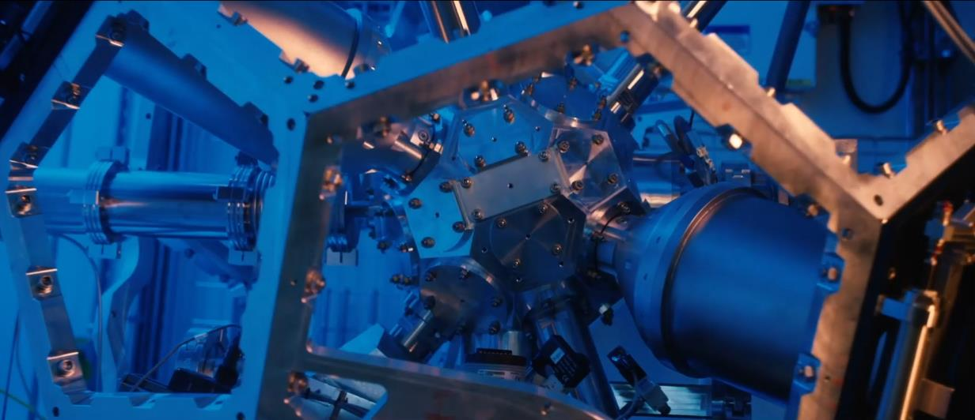
About Brookhaven National Laboratory
https://www.youtube.com/watch?v=csgXRPV0R3A

Slide 6
Agenda
A National Challenge is Your Opportunity
What is Scientific Computing?
Differentiating SciComp from CompSci
SciComp as a Translational Science
Scientific Computing Skills and STEM Internships
SciComp101 Topics & Syllabus
Installing Thonny
Writing your first Python program

Slide 7
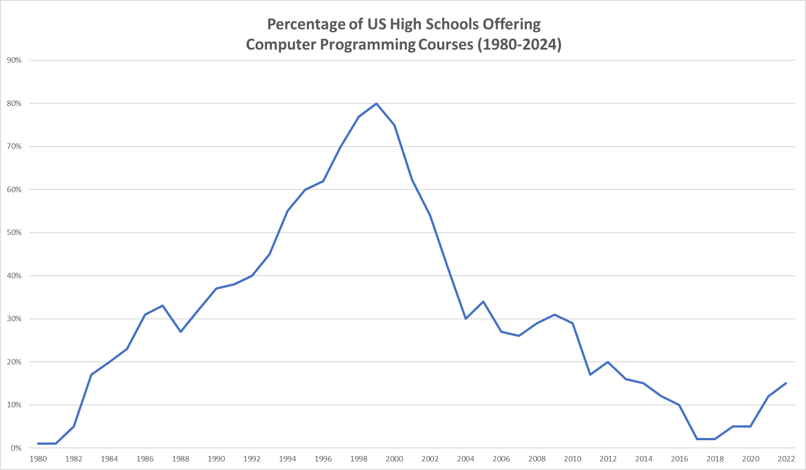
A National Challenge
National Center for Education Statistics, US Dept. of Education

Slide 8
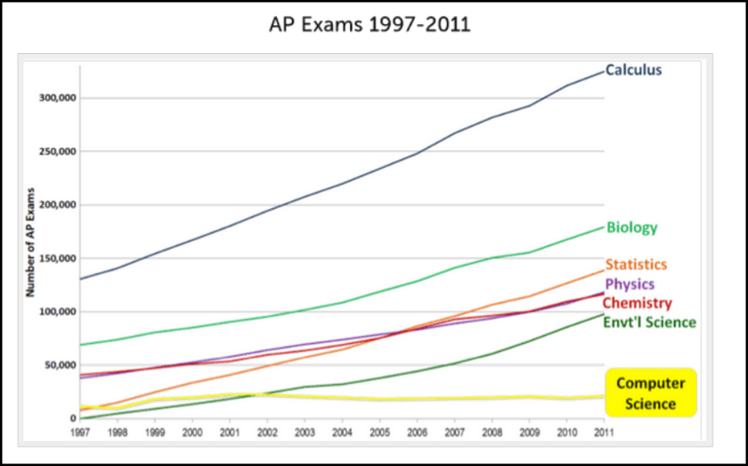
A National Challenge

Slide 9
The Challenge to DOE
Scientists across DOE have noted a dramatic rise in the startup latency of interns who do not possess foundational programming skills
This latency means that for the initial 6-8 weeks of their assignment, the interns are essentially unproductive as they must first acquire basic knowledge of how to write software
Instead of learning critical scientific principles from their mentor, the interns are spending their precious lab time often working alone, figuring out how to instruct the computer to perform rudimentary data processing tasks
From the perspective of DOE scientists, the need to adeptly wield software tools has never been as urgent as it is today

Slide 10
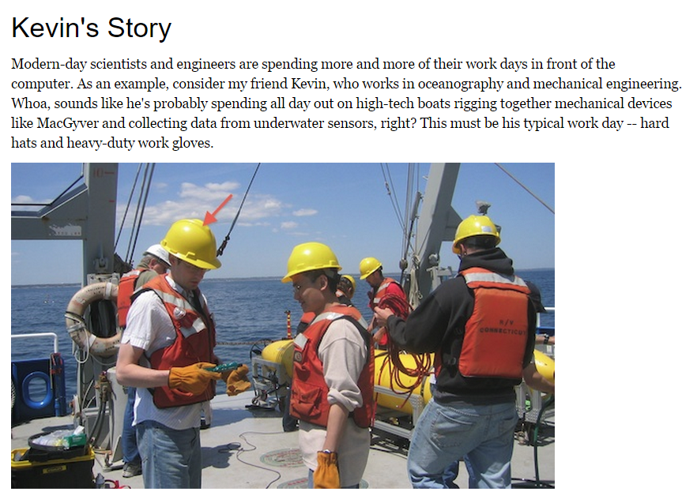
The Hype

Slide 11
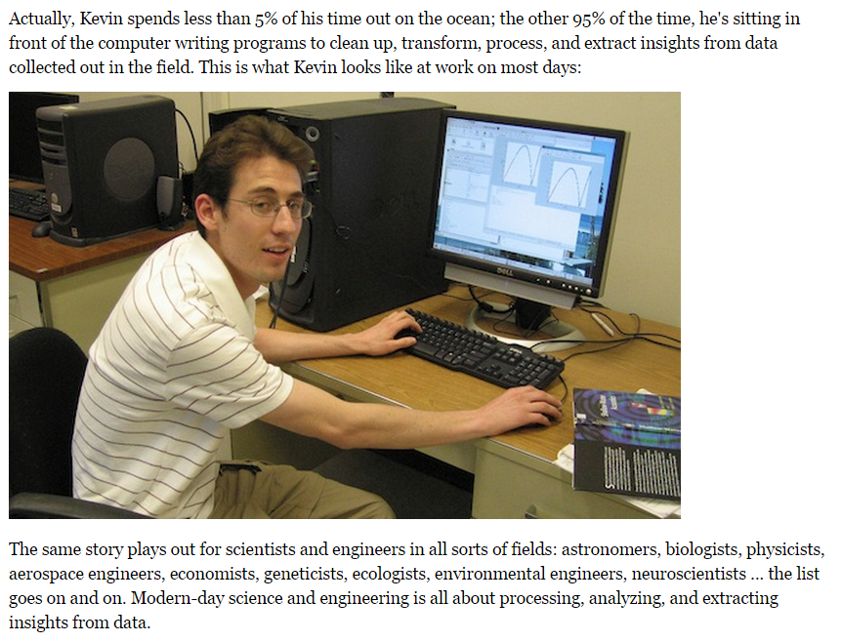
The Reality

Slide 12
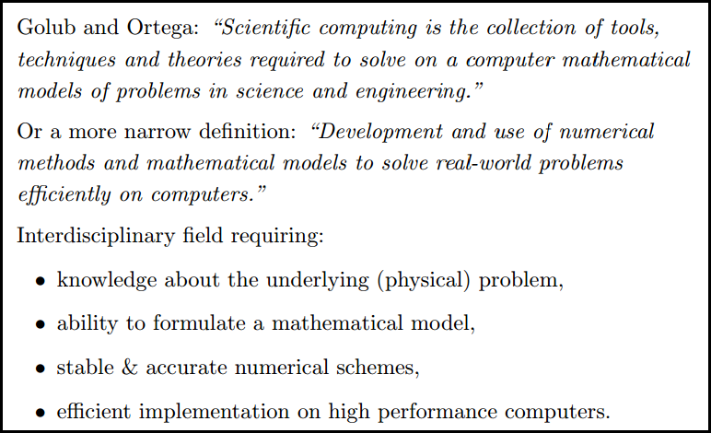
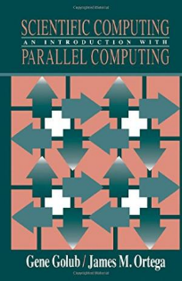
What is Scientific Computing?

Slide 13

What is Scientific Computing?
Scientific computing problems cannot be solved using just a graphing calculator or a spreadsheet program
A computer should not be viewed as just another closed-form benchtop instrument with fixed functionality
SciComp does not require writing thousands of lines of code to answer problems – complete code usually fits on one slide!
SciComp is applied computer science
The first name of CompSci is computer
The first name of SciComp is science
A triple helix of math, science, and computing

Slide 14
SciComp vs CompSci
Scientific Computing
Computer Science
Probability and Statistics
Simulation and Modelling
Data Visualization
Storing and Analyzing Very Large Datasets
Parallel & Distributed Algorithms
Speed and Accuracy Paramount
Functional Languages
Open-Ended Problems with Unknown Solutions
General Data Structures
Design Methodologies
Procedural Languages
Stand-Alone Programs
Emphasis on Object-Orientation
Simple Data Models
Sequential Algorithms
Less Graphics Intensive
Directed Closed-Form Problems with Known Solutions

Slide 15
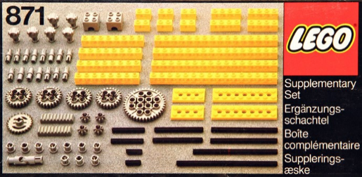
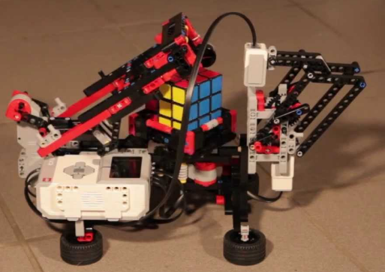
SciComp = Just Enough CompSci
Data types: int, float, bool, string
Data structures: lists, arrays, dictionaries, classes, modules
Functions: def, return
Statements: if, for, while, break
Patterns: vectorization, divide & conquer, list comprehensions
Algorithms: GCD, mean/variance, sorting, searching
Modules: numpy, matplotlib, numba, scipy, sympy, scikit-learn

Slide 16
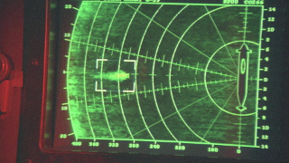
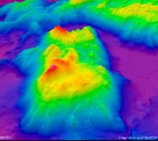


Example SciComp Topic Multidimensional Interpolation
YouTube - Jonsey Reports

Slide 17
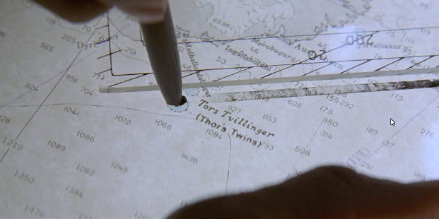
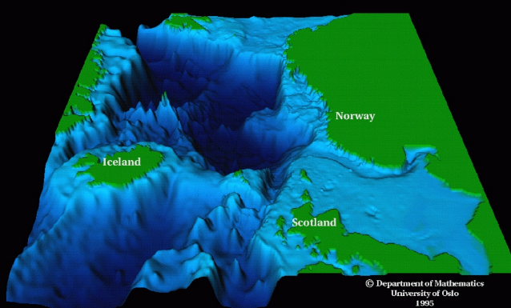
Example SciComp Topic Multidimensional Interpolation
Modi (Brave) and Magni (Strong)

Slide 18
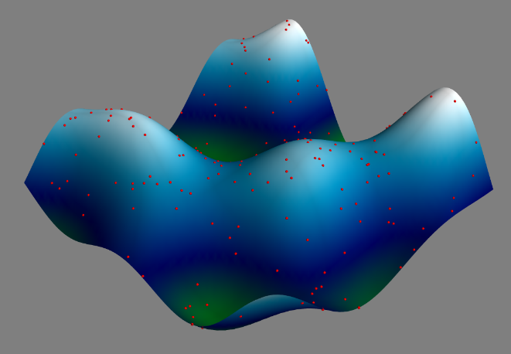
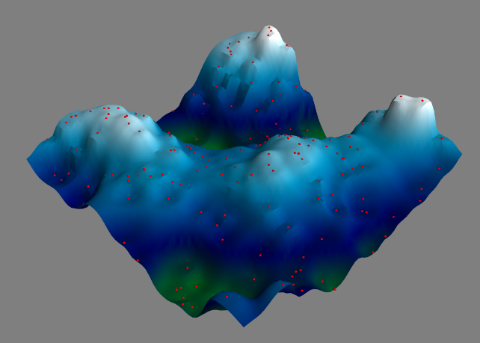
Example SciComp Topic Multidimensional Interpolation
A first order 3-D approximation of the ocean floor based upon only 220 sample (red) points (sonar timings)

Slide 19
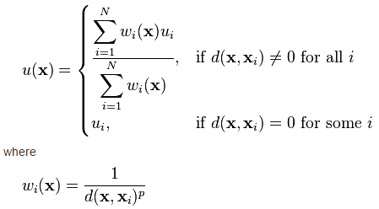
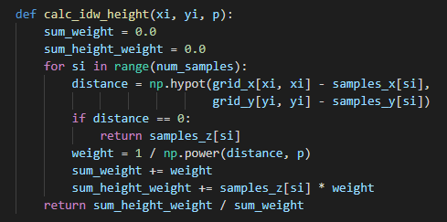
SciComp As Translational Science
"The algorithm that almost won the cold war"
11 lines of code can change the world!
SciComp is the ability to translate mathematical expressions of scientific concepts into correct and efficient software code

Slide 20
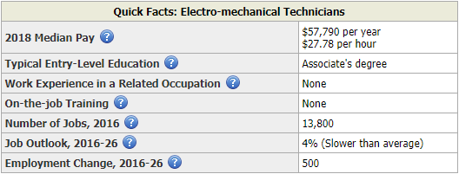
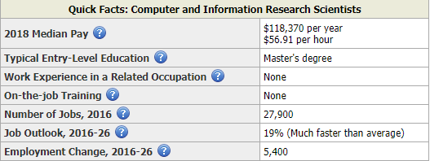
US Department of Labor - 2019
Robotics Engineering Careers
Scientific Computing Careers

Slide 21
The Challenge Facing Educators
How to introduce SciComp into a tightly controlled preexisting science curriculum?
How to control compute resources normally owned by the Math, Engineering, or Business departments?
How to demonstrate solving science problems using code before students complete their first CompSci course?
How to address worries that writing code impairs scientific intuition or reduces the time for hands-on experiences?
How to raise the comfort level of science educators who have not written computer code in years?

Slide 22
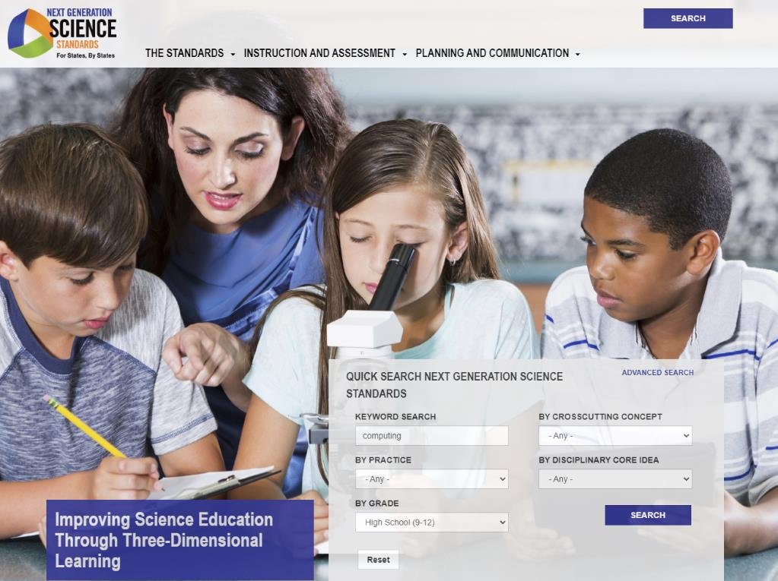
The Challenge Facing Educators
A search for
computing
for HS students
https://www.nextgenscience.org

Slide 23
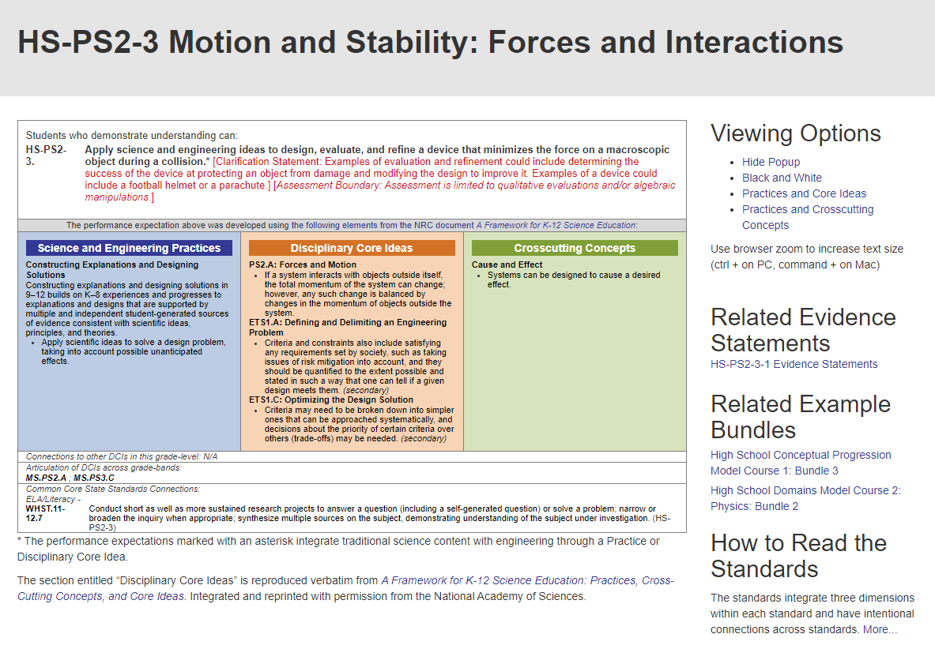
The Challenge Facing Educators
Searches for
computers…
programming…
coding…
return equally generic documents
The word computing doesn't appear once in the "lesson"

Slide 24
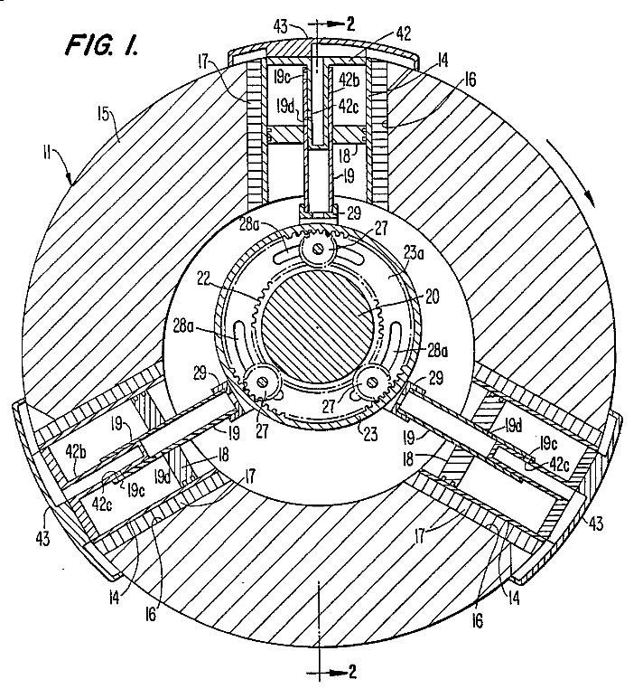
SciComp Is Getting Lost in the Middle
Science courses focus on natural laws, laboratory protocols, physical device manipulation
Math courses focus on formulae, proofs, problem solving mechanics, abstract tasks
A three-rotor Wankel combustion engine is used in military drones
Computer Science courses focus on theory, platforms, tools, languages, business information systems

Slide 25
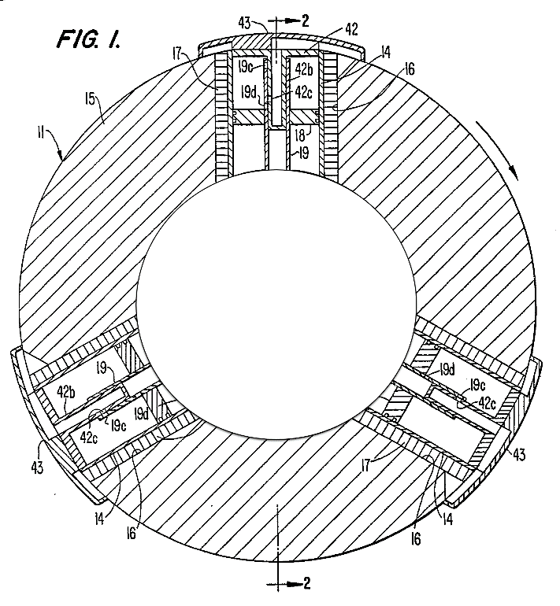
SciComp Is Getting Lost in the Middle
Science courses focus on natural laws, laboratory protocols, physical device manipulation
Math courses focus on formulae, proofs, problem solving mechanics, abstract tasks
SciComp
Historical Departmental Silos
Organizational Inertia
Instructor Readiness
Computer Science courses focus on theory, platforms, tools, languages, business information systems

Slide 26
SciComp 101 Foundations of Scientific Computing
Designed for delivery as a weekly high school extracurricular club, 20 seminars, one-hour duration each
BNL provides all required presentations, sample code, lab exercises, and teacher guide
The software tools are 100% open-source and free of charge
The students can use Windows, Apple Mac, or Chromebook (Linux)
Seminar sessions are split into three 20-minute sections
The last 20-minute section in each session is optional & not required for pedagogical continuity
This structure enables sessions to be delivered within a high school Science Research course during school hours, in a typical 40-minute class period

Slide 27
SciComp 101 Foundations of Scientific Computing
Objectives
Provide patterns for solving real-world science problems by writing custom software
Demonstrate how scientific computing impacts all science disciplines
Enable students to translate scientific formulas into correct and efficient code
Review techniques for the effective visualization of complex data
Show optimal methods to store and analyze very large data sets
Prepare students to conduct interdisciplinary research at world-class institutions

Slide 28
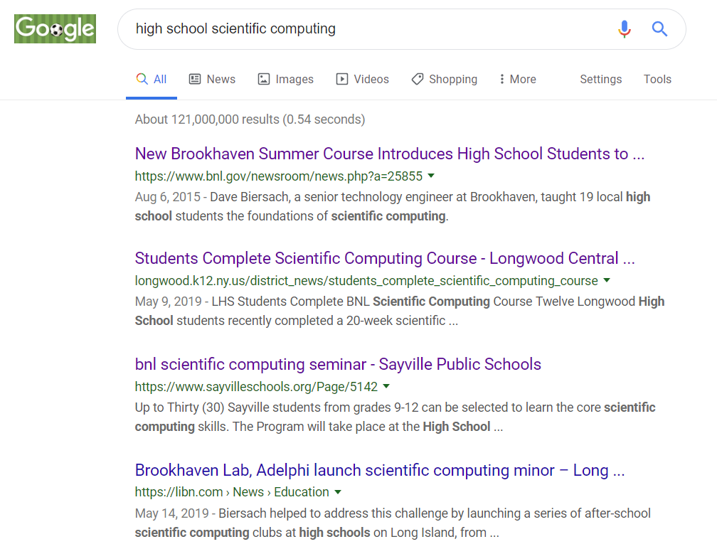
You can lead the world!
Your school could be the top hits in Google!

Slide 29
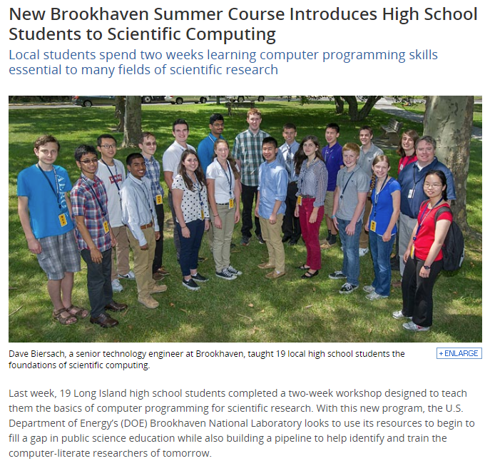
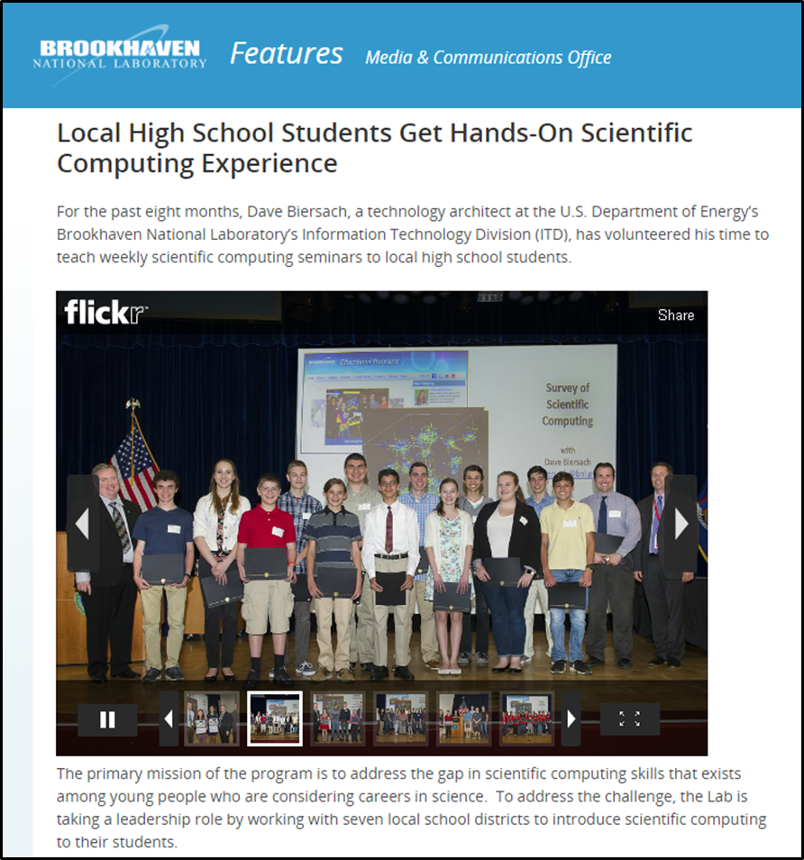

Slide 30
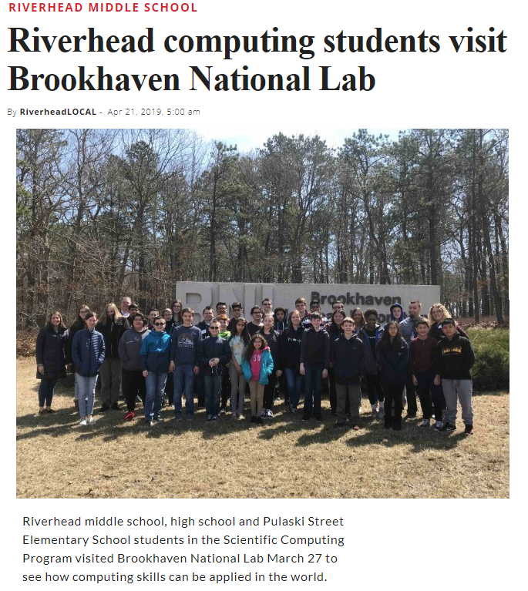
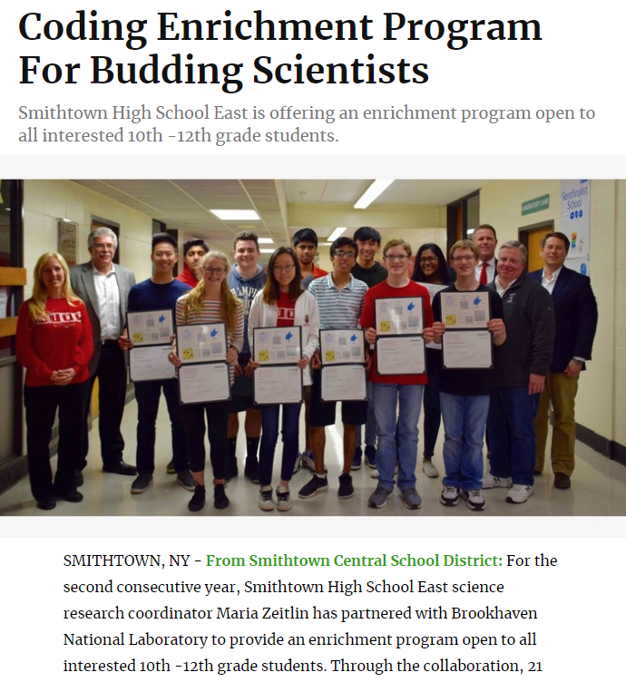
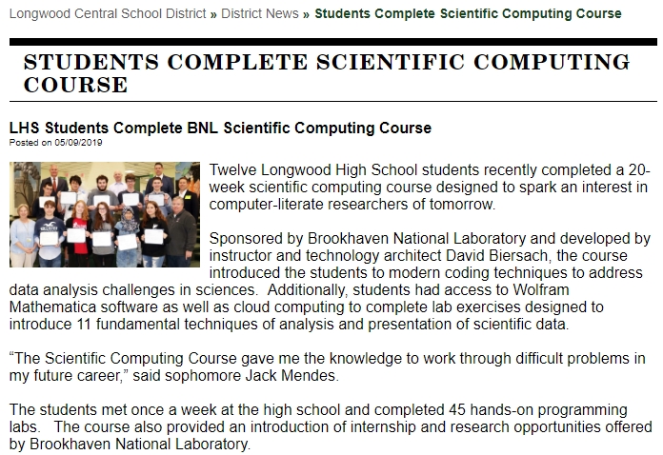

Slide 31


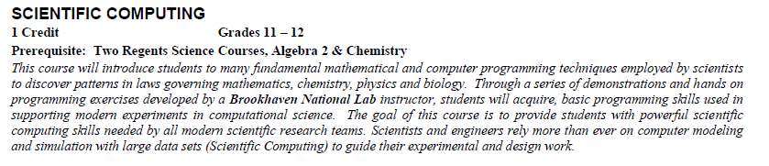
Miller Place High School
First Public High School in NYS to Offer Scientific Computing
Nick Corleto
Chemistry Teacher

Slide 32


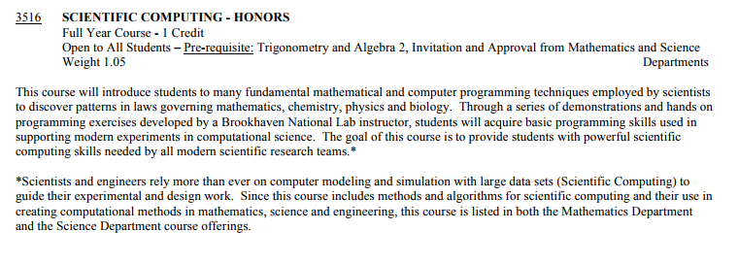
St. Anthony’s High School
First Private High School in NYS to Offer Scientific Computing

Slide 33
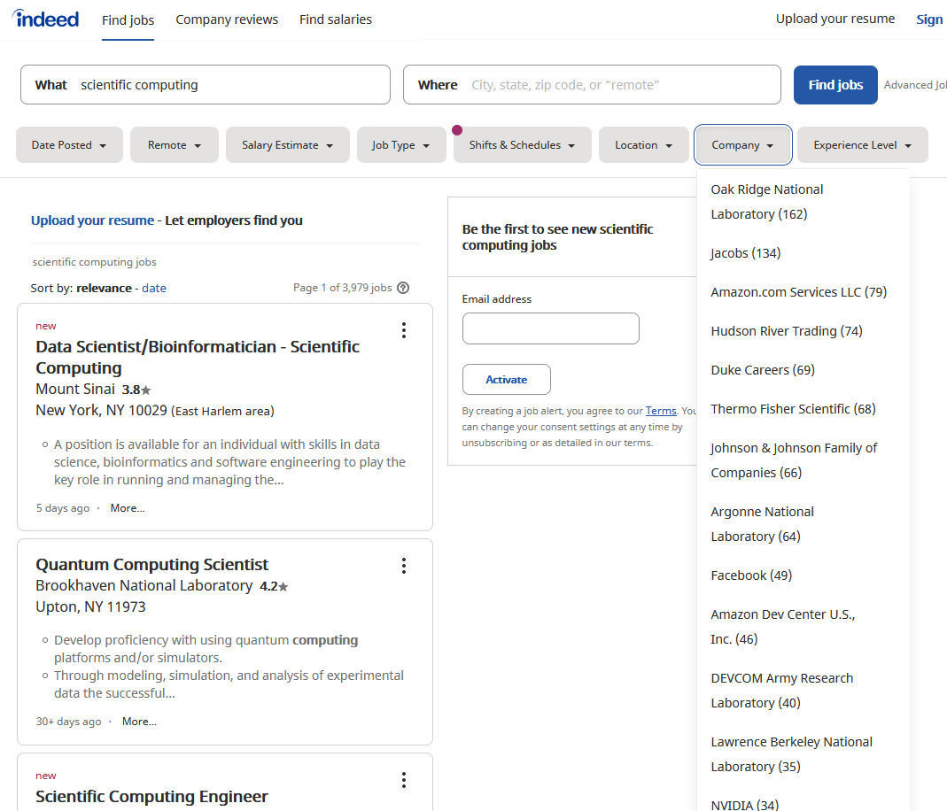
SciComp = The Pathway to Internships

Slide 34
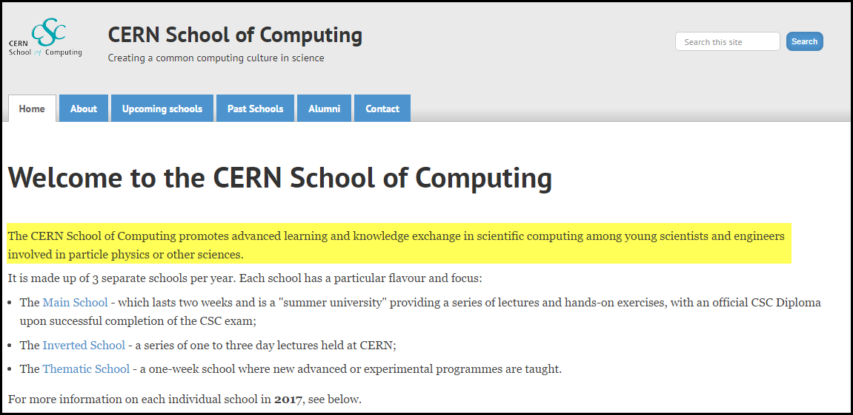
SciComp = The Pathway to Internships
High school interns at CERN must complete a course in Scientific Computing before they can begin their internship.
That is how important CERN views these skills!

Slide 35
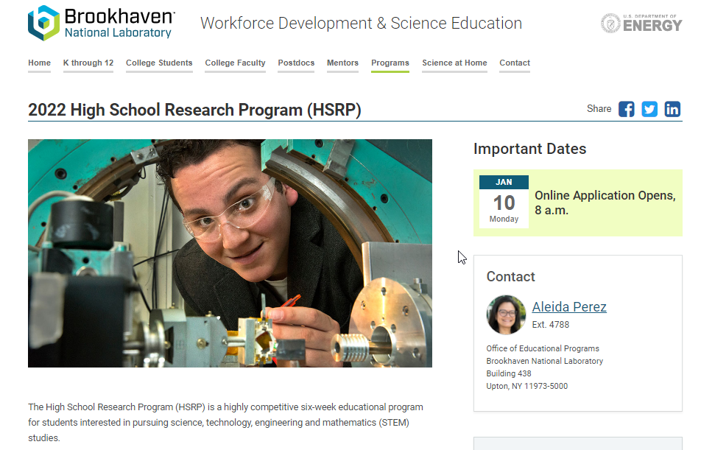
SciComp = The Pathway to Internships
https://www.bnl.gov/education/programs/program.php?q=219

Slide 36

About BNL's High School Research Program

Slide 37
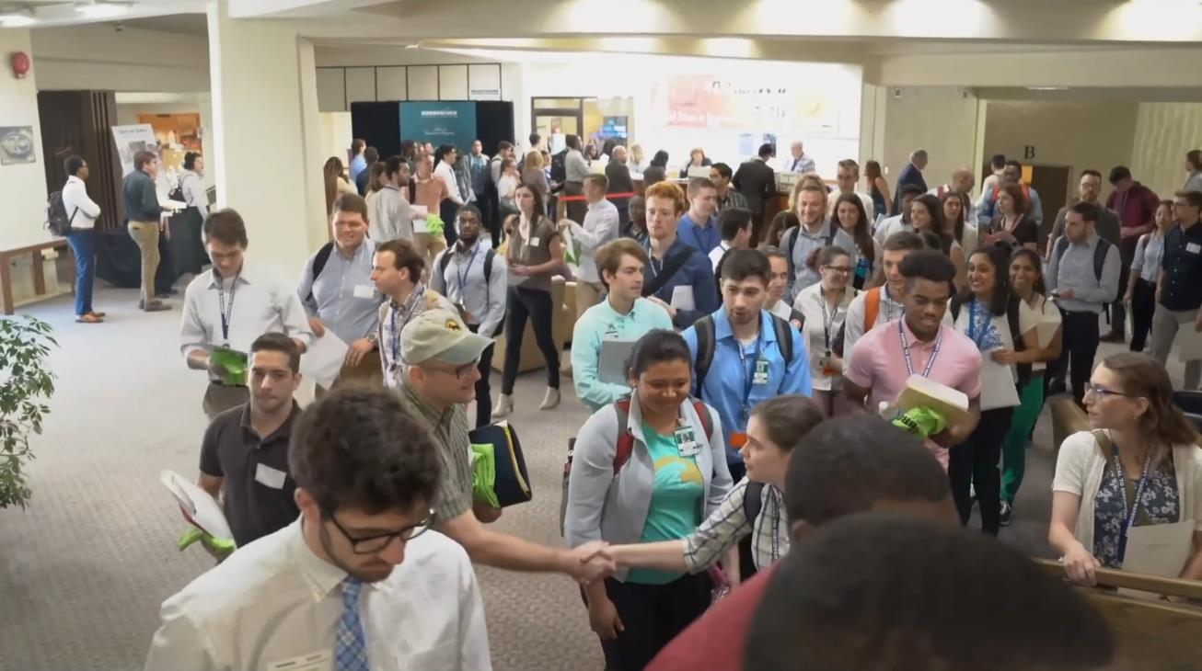
About BNL's College Internships
YouTube - Summer Internship Programs at Brookhaven Lab

Slide 38
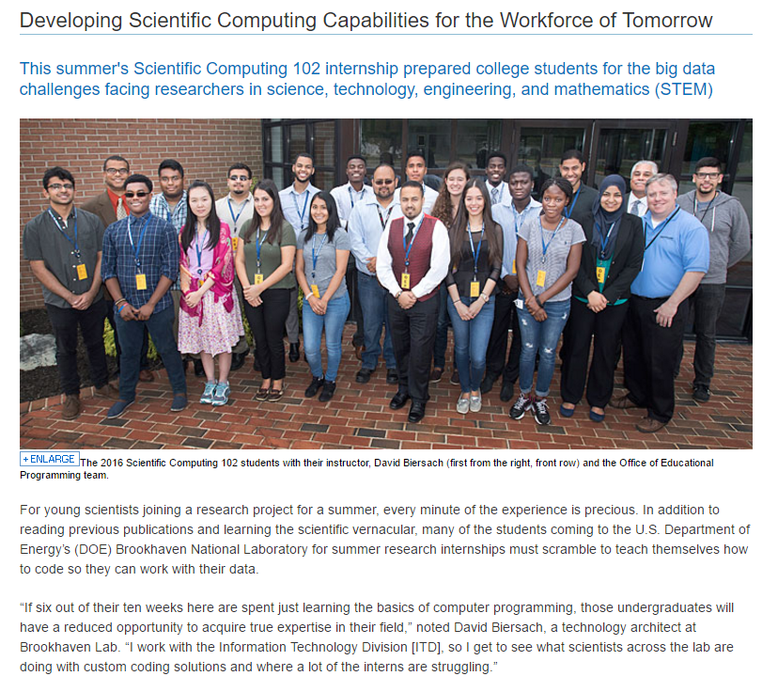
https://www.bnl.gov/newsroom/news.php?a=26599

Slide 39
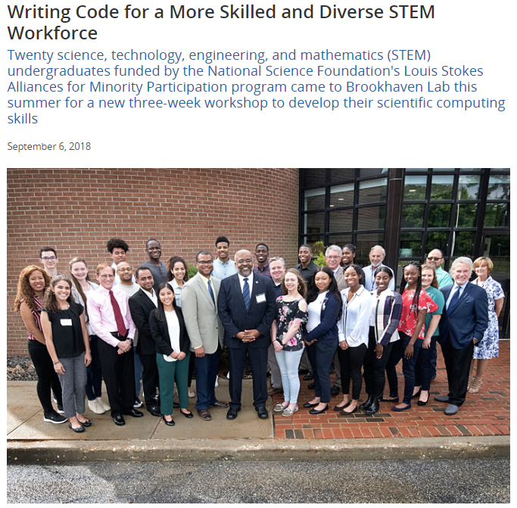
https://www.bnl.gov/newsroom/news.php?a=213064

Slide 40
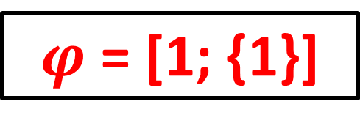
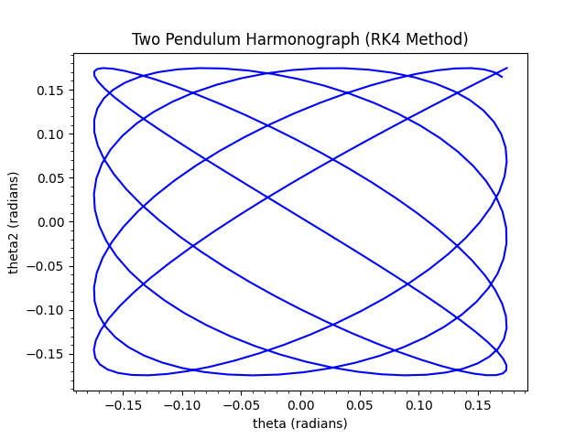
Mathematical Concepts
Systems of Equations
Probability Distributions
Combinatorics
Simulation & Modeling
Monte Carlo Integration
Polar & Spherical Coordinates
Dynamical Systems
Mesh Interpolation
2D Affine Transformations
Vector & Complex Algebra
Signals Analysis
$$\sum_{n=1}^{∞}{\frac{1}{n^{2}}=1+\frac{1}{4}+\frac{1}{9}+\frac{1}{16}+\frac{1}{25}+…=\frac{π^{2}}{6}}$$

Slide 41

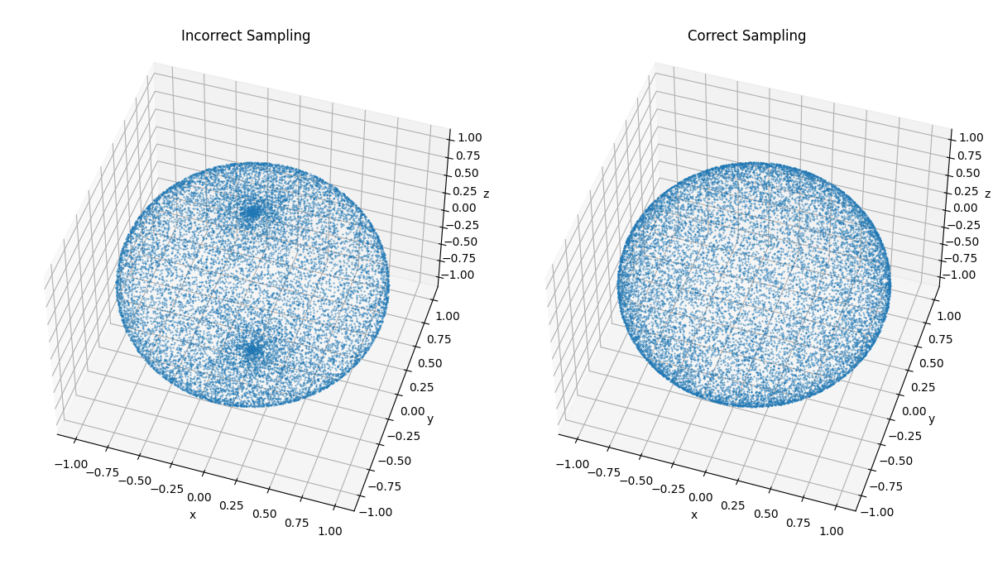
Computer Science Concepts
Representations and Encodings
Random Number Generation
Strings, Arrays, Operators
Loops, Functions, Recursion
Searching & Sorting
2D and 3D Graphics
Accuracy & Precision
Runtime Complexity
File I/O (CSV)

Slide 42
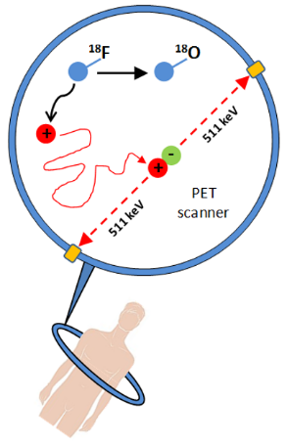
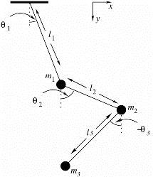
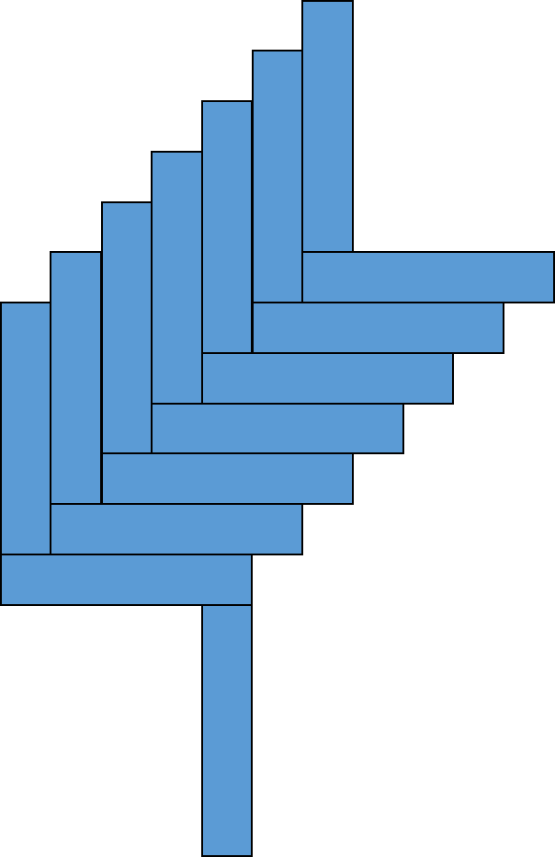
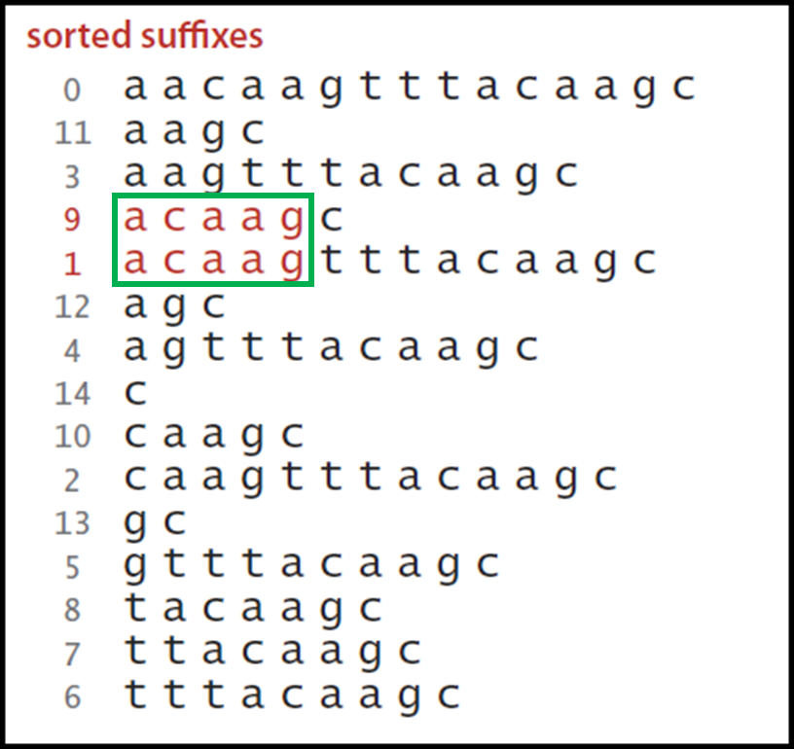
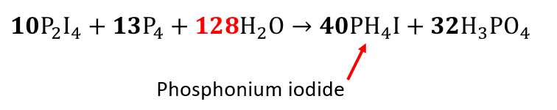
Science Concepts
Mechanics and Kinematics
Waves (Nyquist Sampling)
Unit Conversion
Genetic Sequence Analysis
Balancing Ionic Equations
Projectile Motion
Equilibrium & Thermodynamics
Radioactive Decay

Slide 43
What SciComp 101 Is Not
We are not going to teach you coding for coding’s sake
This is not a simple coding course or "boot camp"
There are lots of great, free, online courses that teach coding
We cannot shy away from complexity
We are not going to teach you "CompSci 101"
We will introduce math and science topics that are new to you
We are professional scientists showing you how to write custom code to solve technical problems
We will focus initially on math and then on science problems
These are the skills high-school interns should have at the start of their summer research project at any US National Lab

Slide 44
Scientific Computing with Python
Python is quickly becoming one of the most heavily used languages in science projects
Python runs on all major modern operating systems and is completely free and open-source (not vendor-controlled)
Python makes it easy for your code to directly integrate with a large spectrum of available 3rd party software
Python code runs consistently on different platforms and scales well from small IoT devices to large server clusters
Python benefits from a very active and growing user community that continues to enhance the language
200,000+ free/open-source packages are readily available!

Slide 45
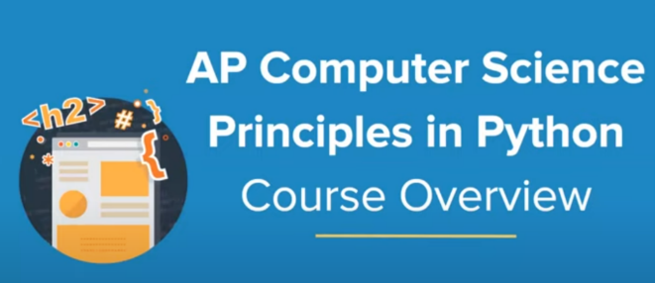

AP Computer Science Exam

Slide 46
Useful Python Reference Sites
https://docs.python.org/3/tutorial
https://www.learnpython.org
https://realpython.com
https://www.w3schools.com/python
https://www.fullstackpython.com

Slide 47
Final Motivations
Every high school science research project can benefit from even just a slight touch of scientific computing
Better statistics & data visualization on posters
Compelling analysis from modeling & simulation
Novel integration of computation is a big differentiator!
The lab exercises we have developed are taken directly from active research projects at BNL
We all learned how to read before we learned how to write - many junior BNL staff inherit existing code to fix or extend
More than 80% of all summer research projects at BNL require high school interns to write code

Slide 48
Final Motivations
It does not take thousands of lines of code to keep important science moving right along…
You don’t have to be a professional programmer or know all the arcane aspects of computer languages
The closer you get to cutting-edge science, the less likely you’ll be to “download an app” to accomplish what you need
If you don’t know how to code…
You will start to subconsciously limit the types of analysis you can perform because you will remain at the mercy of the available software
Will software limit your science? Or will you create software to advance science for all?

Slide 49


Slide 50

(Windows) Step 1 – Install Git
https://git-scm.com/install/windows

Slide 51

(Windows) Step 2 – Install VS Code
https://code.visualstudio.com/download

Slide 52


(Windows) Step 3 – Install Astral “uv”
In a new PowerShell window…
powershell -ExecutionPolicy ByPass -c "irm https://astral.sh/uv/install.ps1 | iex"
https://docs.astral.sh/uv/getting-started

Slide 53

(Windows) Step 4 – Clone SciComp101 Repo
In the same PowerShell window…
git clone https://github.com/dbiersach/scicomp101

Slide 54

(Windows) Step 5 – Install VS Code Extensions
In the same PowerShell window…
cd scicomp101
.\install_vscode_extensions.ps1

Slide 55

(Windows) Step 6 – Create Python .venv
In the same PowerShell window…
uv sync

Slide 56

(Windows) Step 7 – Open the Workspace

Slide 57

(Windows) - Trust the Workspace

Slide 58

(macOS) Step 0 – Install Homebrew
Only do this if you do not already have Homebrew installed on your Mac…
https://github.com/Homebrew/brew/releases/download/5.0.2/Homebrew-5.0.2.pkg

Slide 59

(macOS) Step 1 – Install Git
In a new Terminal window…
brew install git

Slide 60

(macOS) Step 2 – Install VS Code
In the same Terminal window…
brew install --cask visual-studio-code

Slide 61

(macOS) Step 3 – Install Astral “uv”
In the same Terminal window…
brew install uv
https://docs.astral.sh/uv/getting-started

Slide 62

(macOS) Step 4 – Clone SciComp101 Repo
In the same Terminal window…
git clone https://github.com/dbiersach/scicomp101

Slide 63
(macOS) Step 5 – Install VS Code Extensions
In the same Terminal window…
cd scicomp101
bash ./install_vscode_extensions.sh

Slide 64

(macOS) Step 6 – Create Python .venv
In the same Terminal window…
uv sync

Slide 65

(macOS) Step 7 – Open the Workspace

Slide 66
(macOS) - Trust the Workspace

Slide 67

Open hello_world.py

Slide 68
Select Python Interpreter (if necessary)

Slide 69

Select Python Interpreter (if necessary)

Slide 70

Confirm Python Interpreter

Slide 71

Edit hello_world.py
Note: Type this code statement exactly as it appears here

Slide 72

Run hello_world.py

Slide 73
Session 01 – Now You Know…
Scientific Computing is not the same as Computer Science
You cannot do modern science without knowing how to program a computer (not just use a computer)
The US Department of Energy offers high school and college internships at 17 National Laboratories across the USA
One of the best ways to differentiate yourself from other students competing for internships is to develop foundational skills in scientific computing
AP College Board is now offering exams in Python
Thonny is a 100% open-source (and cost-free) integrated development environment (IDE) for Python created by selfless programmers around the world

Slide 74

TASK 01
Add new code to the Python script file my_quip.py to print a quip of your choosing or creation
Ensure your program runs correctly before exiting VS Code

